Slide 1
VisualAnalyticDashboard_Final_Project_Group9 1
File created on: 8/5/24 3:24:37 PM EDT

Slide 2
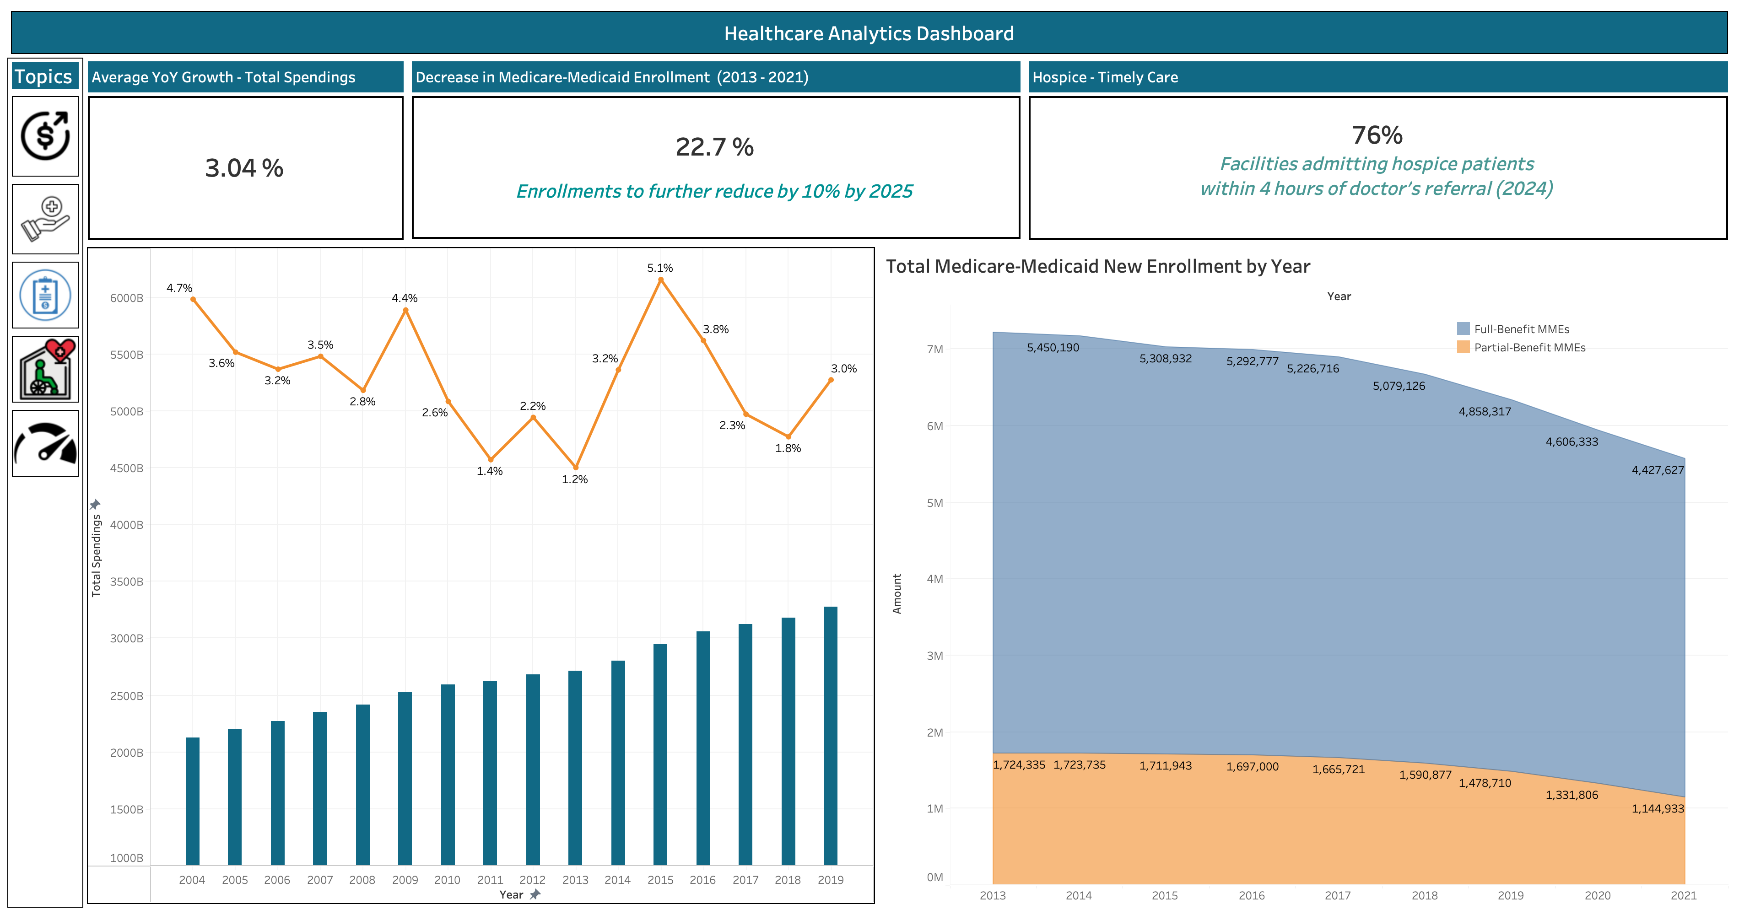

Slide 3
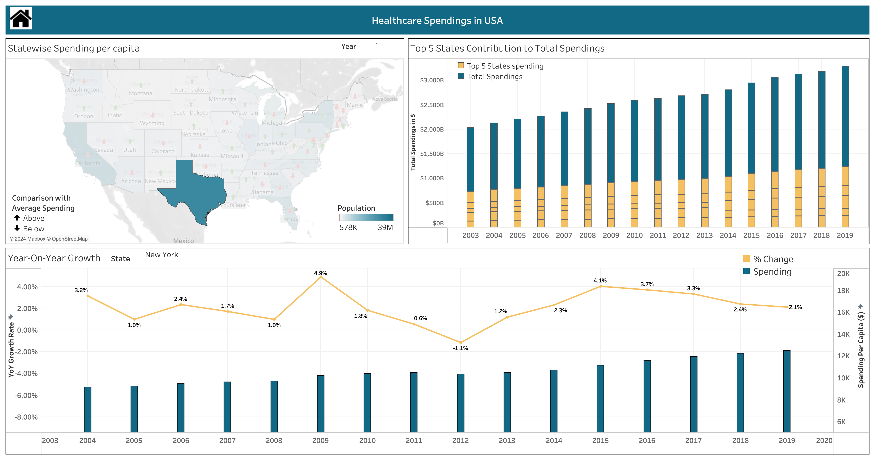

Slide 4
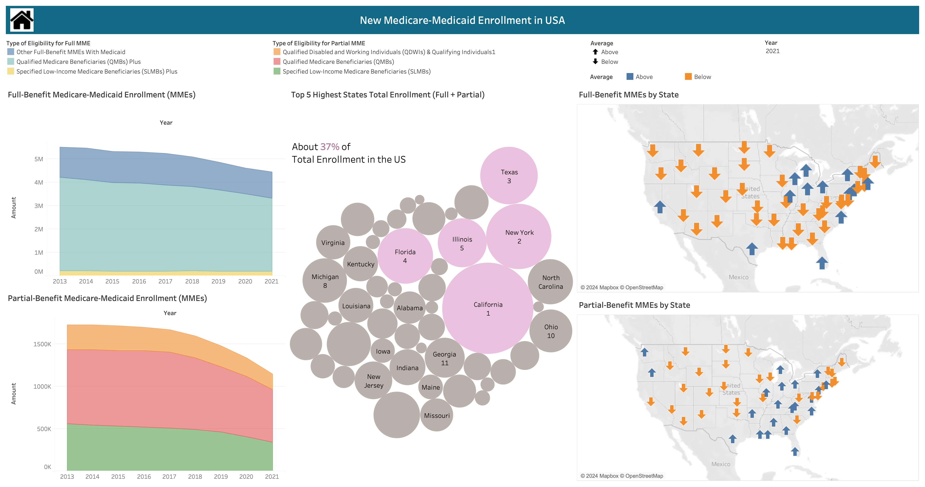

Slide 5
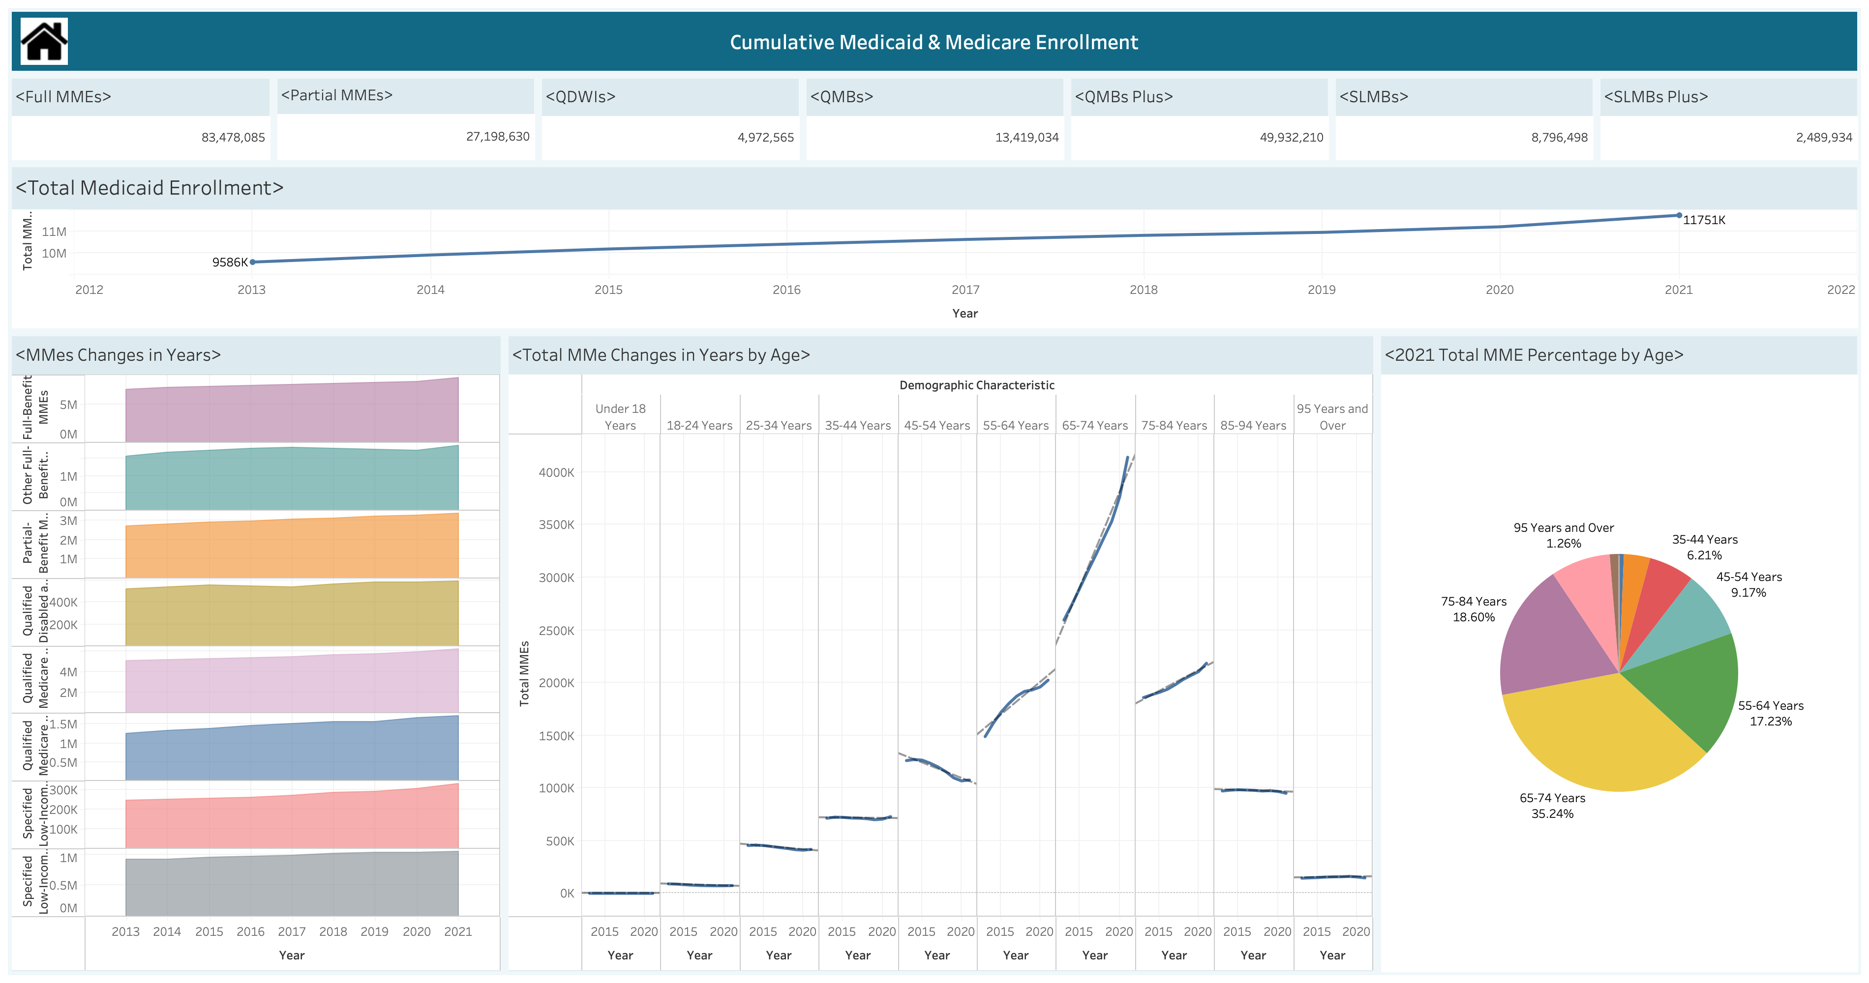

Slide 6
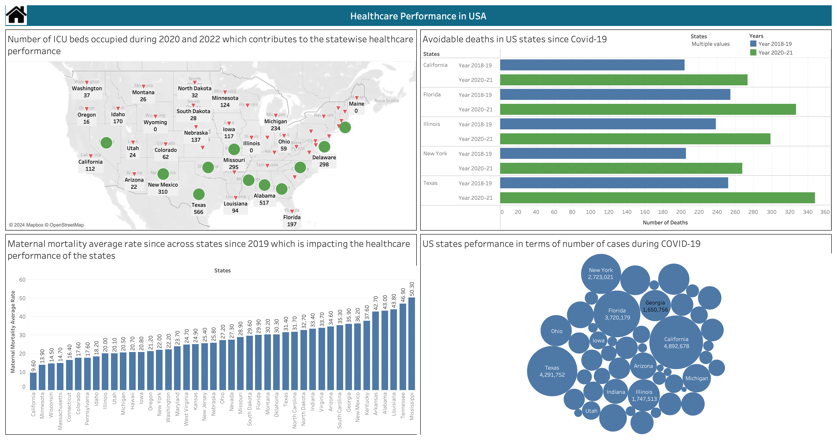

Slide 7
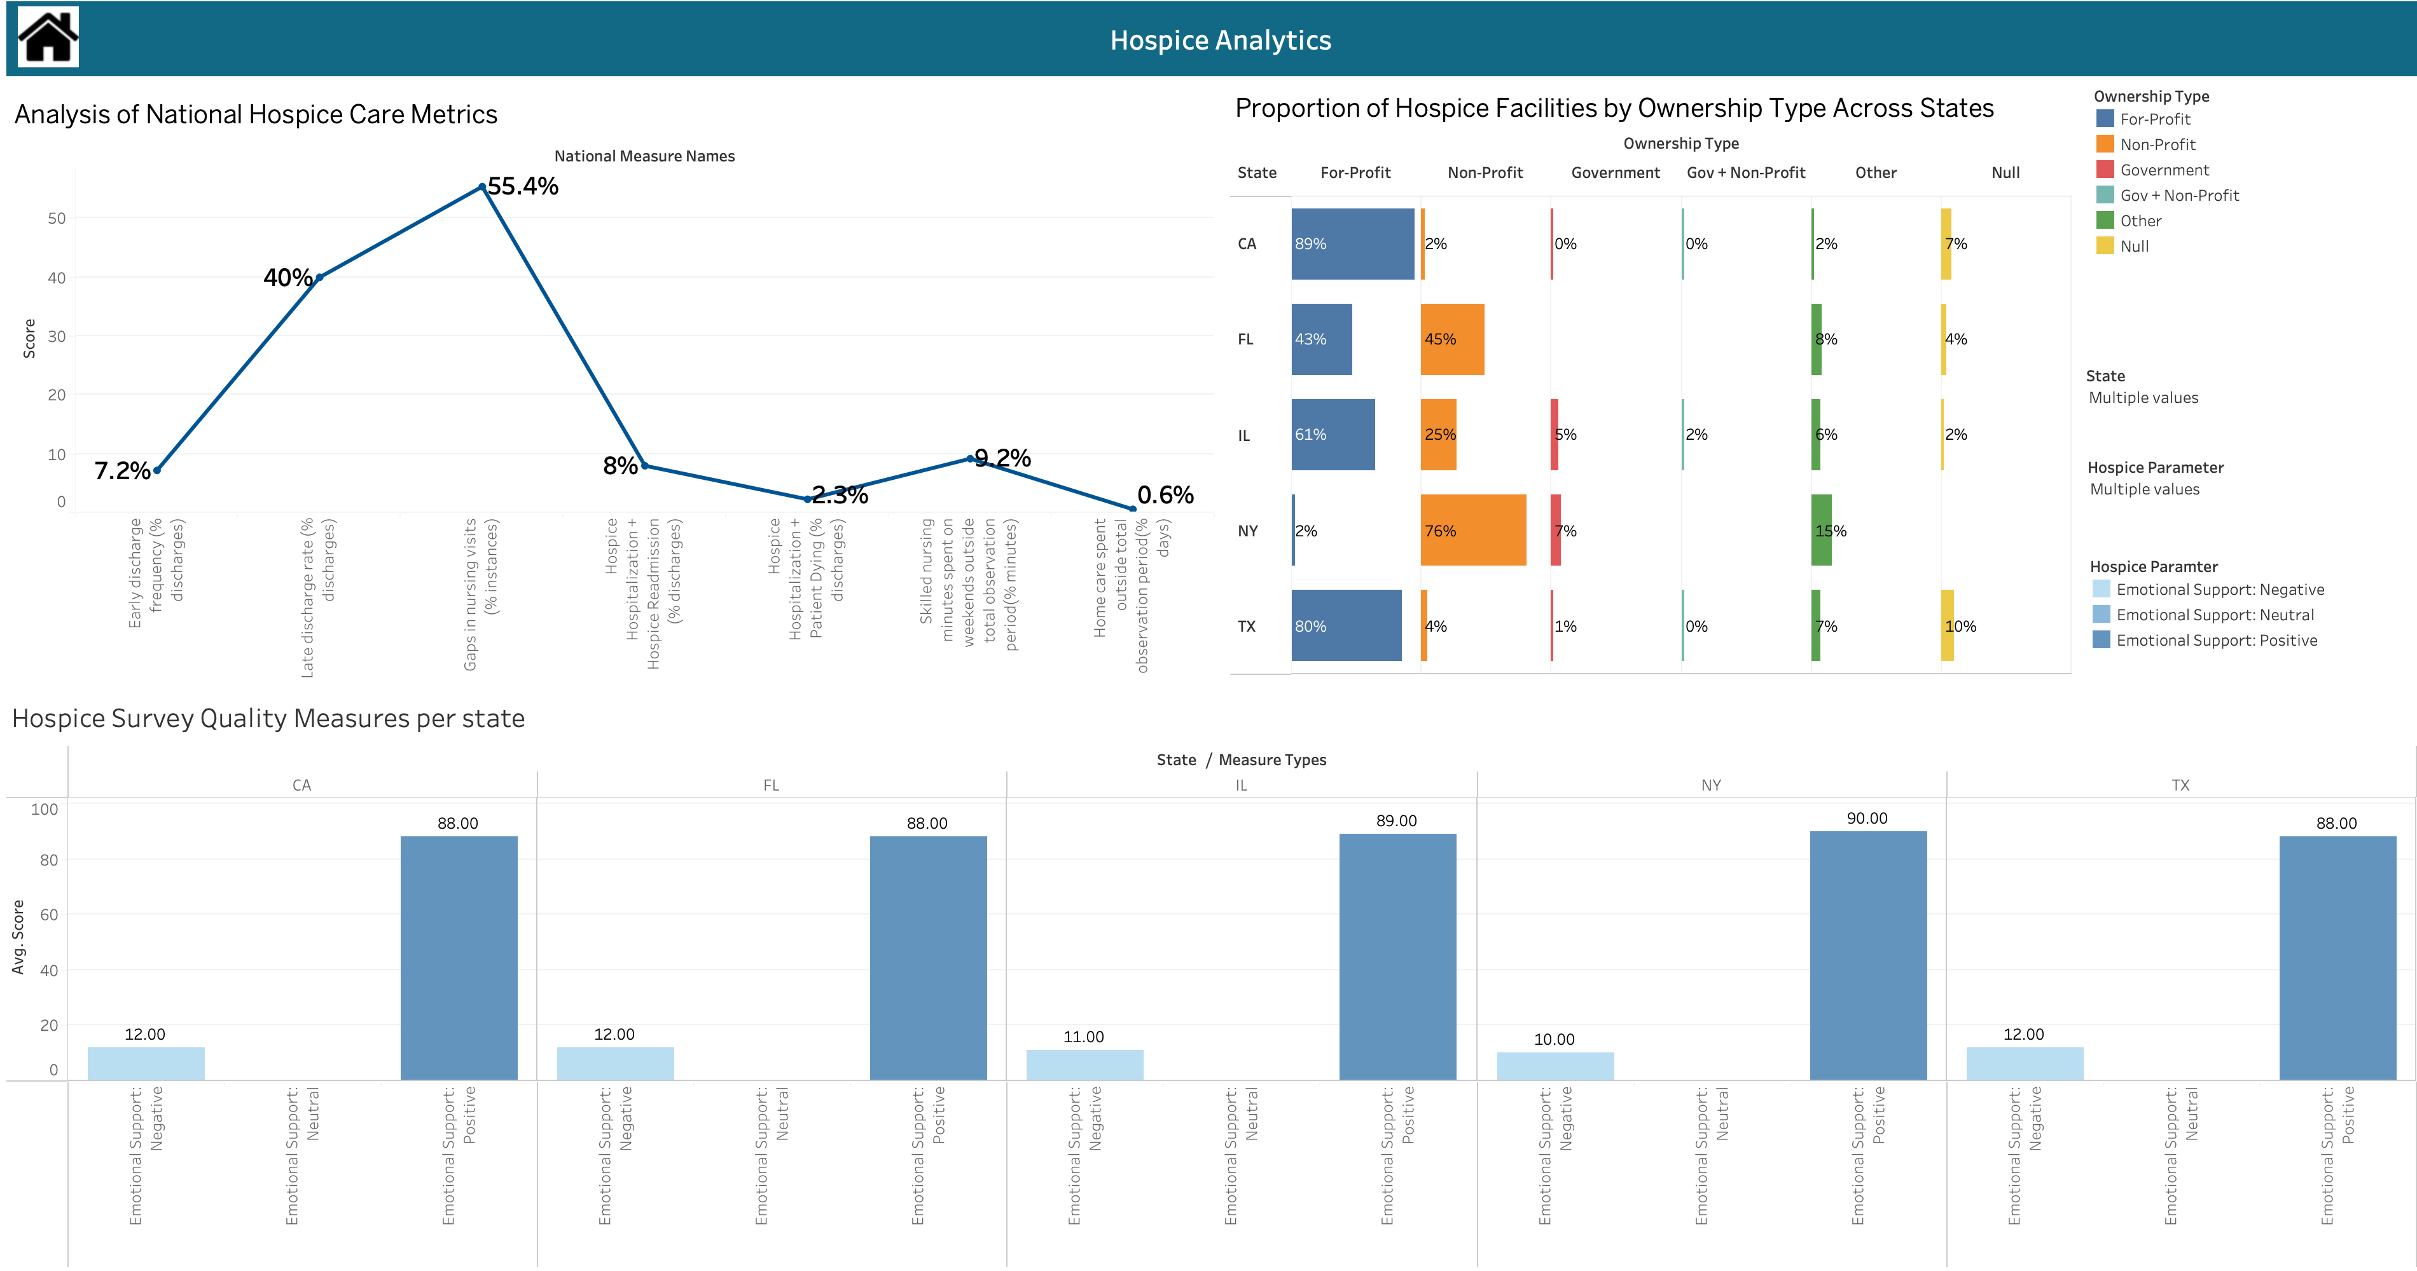

Slide 8
